Slide 1
Chapter Seven
Customer-Driven Marketing Strategy
Creating Value for Target Customers

Slide 2
Customer-Driven Marketing Strategy:
Creating Value for Target Customers
Topic Outline
Customer-Driven Marketing Strategy
Market Segmentation
Market Targeting
Differentiation and Positioning

Slide 3
Market Segmentation
Market segmentation is the process that companies use to divide large, heterogeneous markets into small markets that can be reached more efficiently and effectively with products and services that match their unique needs

Slide 4
Market Segmentation
Segmenting consumer markets
Segmenting business markets
Segmenting international markets
Requirements for effective segmentation

Slide 5
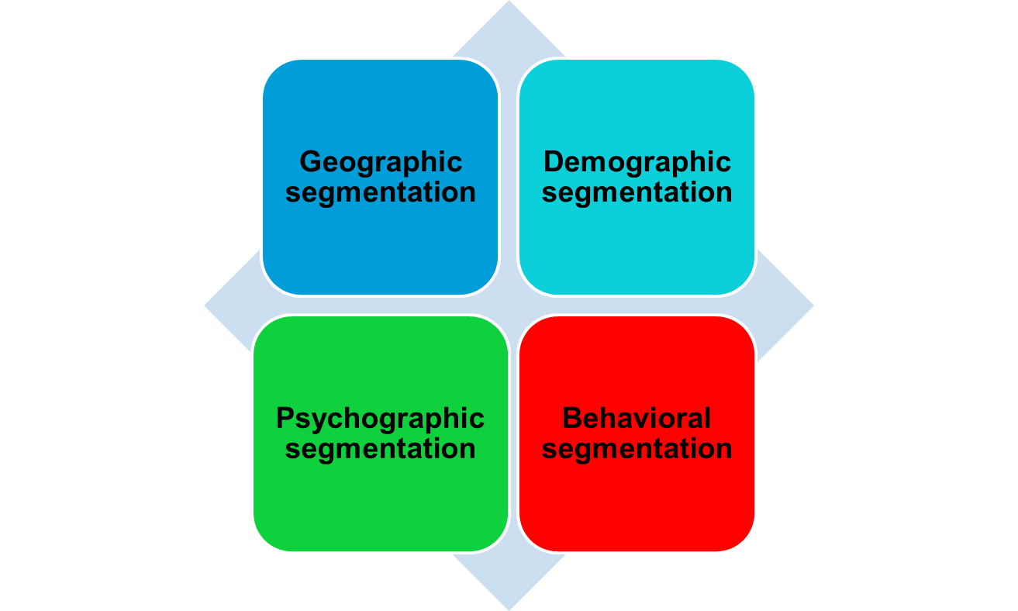
Market Segmentation
Segmenting Consumer Markets

Slide 6
Market Segmentation
Segmenting Consumer Markets
Geographic segmentation divides the market into different geographical units such as nations, regions, states, counties, or cities

Slide 7
Market Segmentation
Segmenting Consumer Markets
Demographic segmentation divides the market into groups based on variables such as age, gender, family size, family life cycle, income, occupation, education, religion, race, generation, and nationality

Slide 8
Market Segmentation
Age and life-cycle stage segmentation is the process of offering different products or using different marketing approaches for different age and life-cycle groups
Gender segmentation divides the market based on Gender (male or female)

Slide 9
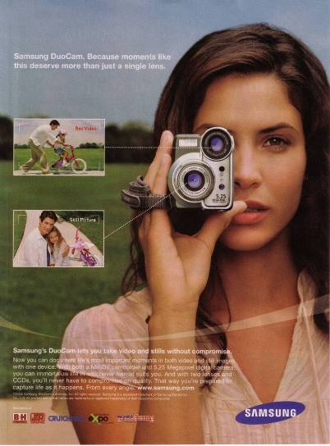
Family Life Cycle Advertising
Video cameras are often purchased by young couples with children.
Copyright 2007 by Prentice Hall

Slide 10
Market Segmentation
Segmenting Consumer Markets
Income segmentation divides the market into affluent or low-income consumers
Psychographic segmentation divides buyers into different groups based on social class, lifestyle, or personality traits

Slide 11

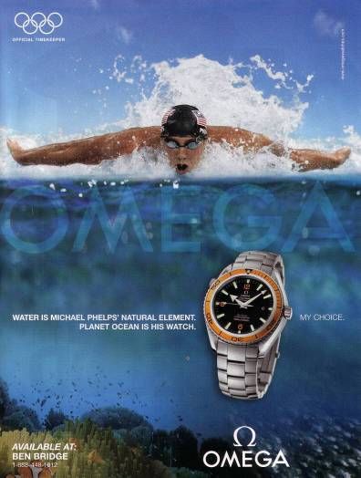
Two High-End Watches for Different Psychographic Segments
Copyright 2007 by Prentice Hall

Slide 12
Market Segmentation
Segmenting Consumer Markets
Behavioral segmentation divides buyers into groups based on their knowledge, attitudes, uses, or responses to a product
Occasions
Benefits sought
User status
Usage rate
Loyalty status

Slide 13
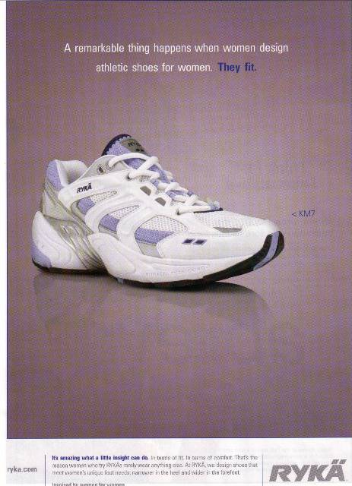
Ryka produces sneakers that meet the special needs of women’s feet.
Copyright 2007 by Prentice Hall

Slide 14
Market Segmentation
Using Multiple Segmentation Bases
Multiple segmentation is used to identify smaller, better-defined target groups
Geodemographic segmentation is an example of multivariable segmentation that divides groups into consumer lifestyle patterns

Slide 15
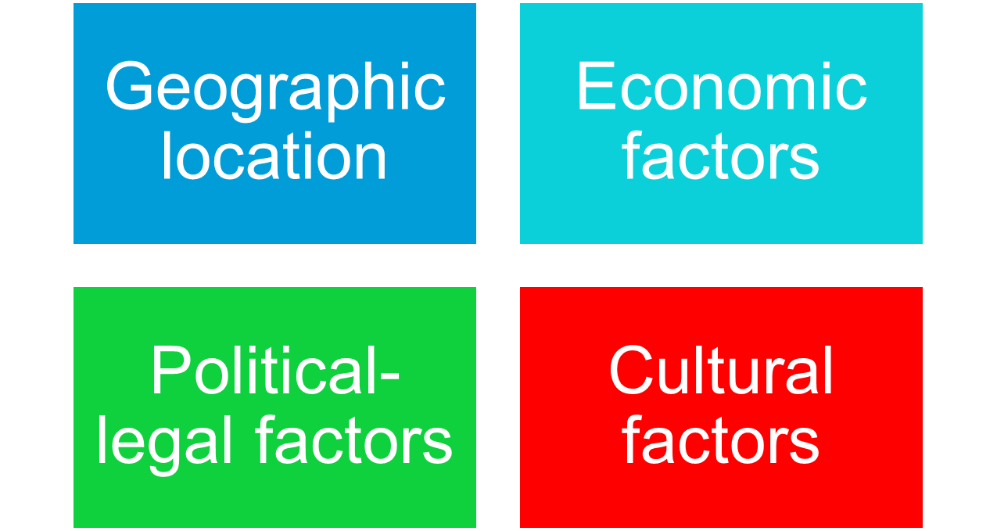
Market Segmentation
Segmenting International markets

Slide 16
Market Segmentation
Segmenting Business Markets
Intermarket segmentation divides consumers into groups with similar needs and buying behaviors even though they are located in different countries

Slide 17
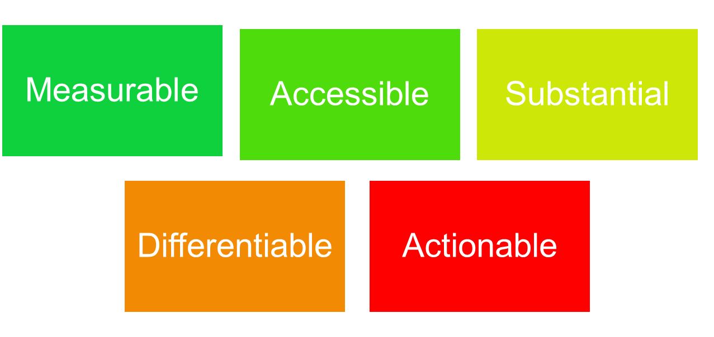
Market Segmentation
Requirements for Effective Segmentation
To be useful, market segments must be:

Slide 18

Measurable
Requirements for Effective Segmentation
Accessible
Substantial
Size, purchasing power, profiles
of segments can be measured.
Differential
Segments must be effectively
reached and served.
Actionable
Segments must be large or profitable enough to serve.
Segments must respond differently to different marketing mix elements & actions.
Must be able to attract and serve the segments.
Notes:
Effective Segmentation
This CTR relates to the material on pp. 215.
Requirements for Effective Segmentation
Measurability . This refers to the degree to which the size and purchasing power of the segments can be measured. The accuracy and availability of measures of market potential are important.
Accessibility. This refers to the degree to which a market segment can be reached and served. Identifying a segment is useless if the marketer has limited access to the customer.
Substantiality. This refers to the degree to which the segments are large or profitable enough to service.
Actionability. This is the degree to which an effective marketing program can be designed for attracting and serving segments. Company resource limitations figure prominently in actionability issues.

Slide 19
Market Targeting
Selecting Target Market Segments
Target market consists of a set of buyers who share common needs or characteristics that the company decides to serve

Slide 20
Market Targeting
Evaluating Market Segments
.
Segment Size and Growth
  Analyze sales, growth rates and expected profitability.
Segment Structural Attractiveness
  Consider effects of: Competitors, Availability of Substitute
  Products and, the Power of Buyers & Suppliers.
Company Objectives and Resources
  Company skills & resources relative to the segment(s).
  Look for Competitive Advantages.

Slide 21
Market Targeting
Market Coverage Strategies
Company
Marketing
Mix
Market
Company
Marketing Mix 1
Segment 1
Company
Marketing Mix 2
Segment 2
A. Undifferentiated Marketing
Company
Marketing Mix 3
Segment 3
Segment 1
Company
Marketing
Mix
Segment 2
B. Differentiated Marketing
Segment 3
C. Concentrated Marketing
Notes:
Market Coverage Strategies
This CTR corresponds to Figure 7-4 on p. 217 and relates to the discussion on pp. 216-219.
Market Coverage Strategies
Undifferentiated Marketing. This strategy uses the same marketing mix for the entire market. This strategy focuses on the common needs of the market rather than differences in it. Undifferentiated marketing provides economies of scale on product costs but may be limited in application.
Differentiated Marketing. This strategy targets several market segments and designs separate marketing mixes for each of them. Product and marketing variation also helps company image and may produce loyalty in consumers as they change segments.
Concentrated Marketing. This strategy commits a company to pursue a large share of one or more submarkets. Economies and segment knowledge and service are strengths of this approach but risk due to smaller market size is greater.

Slide 22




Market Segmentation
Levels of Market Segmentation
Mass Marketing
Same product to all consumers
(no segmentation)
Segment Marketing
Different products to one or more segments
(some segmentation)
Niche Marketing
Different products to subgroups within segments
( more segmentation)
Micromarketing
Products to suit the tastes of individuals or locations
(complete segmentation)
Notes:
Stages in Market Orientation
This CTR relates to the discussion on pp. 197-202.
Stages in Market Orientation
Sellers traditionally have passed through three stages of orientation or philosophy of identifying markets that lead to greater use of segmentation, targeting, and positioning strategies:
Mass Marketing. In mass marketing, the seller produces, mass distributes, and mass promotes one product to all buyers. The argument for mass marketing is that it [should] lead to the lowest costs (through economies of scale) and prices and create the largest potential market.
Segment Marketing. Here the seller identifies market segments, selects one or more of them, and develops products and marketing mixes tailored to meeting the needs of those selected segments. As more competitors adopt this practice, fragmentation of the market leads to
Niche Marketing. Here the seller focuses on subgroups within market segments who may seek a special combination of benefits.
Micromarketing. This is the practice of tailoring products and marketing programs to suit the tastes of specific individuals and locations.

Slide 23
Market Targeting
Target Marketing Strategies
Undifferentiated marketing targets the whole market with one offer
  Mass marketing
  Focuses on common needs rather than what’s different

Slide 24
Market Targeting
Target Marketing Strategies
Differentiated marketing targets several different market segments and designs separate offers for each
Goal is to achieve higher sales and stronger position
More expensive than undifferentiated marketing

Slide 25
Market Targeting
Target Market Strategies
Concentrated marketing targets a small share of a large market
Limited company resources
Knowledge of the market
More effective and efficient

Slide 26
Marketing Targeting
Target Market Strategies
Micromarketing is the practice of tailoring products and marketing programs to suit the tastes of specific individuals and locations
Local marketing
Individual marketing

Slide 27
Market Targeting
Target Market Strategies
Local marketing involves tailoring brands and promotion to the needs and wants of local customer groups
Cities
Neighborhoods
Stores

Slide 28
Market Targeting
Target Market Strategies
Individual marketing involves tailoring products and marketing programs to the needs and preferences of individual customers
Also known as:
  One-to-one marketing
  Mass customization
  Markets-of-one marketing

Slide 29
Market Targeting
Choosing a Targeting Strategy
Depends on:
Company resources
Product variability
Product life-cycle stage
Market variability
Competitor’s marketing strategies

Slide 30
Market Targeting
Socially Responsible Target Marketing
Benefits customers with specific needs
Concern for vulnerable segments
Children
  Alcohol
  Cigarettes

Slide 31
Differentiation and Positioning
Product position is the way the product is defined by consumers on important attributes—the place the product occupies in consumers’ minds relative to competing products
  Perceptions
  Impressions
  Feelings

Slide 32
Differentiation and Positioning
Positioning maps show consumer perceptions of their brands versus competing products on important buying dimensions

Slide 33
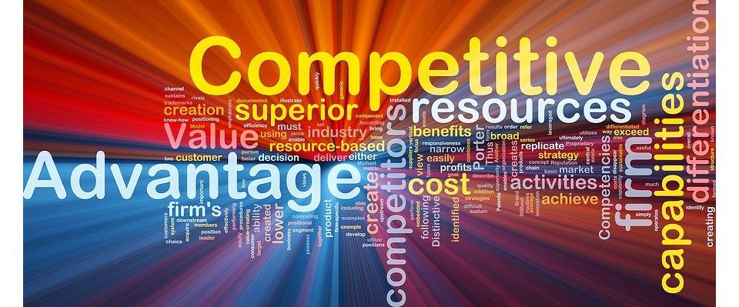


Slide 34
Differentiation and Positioning
Identifying Possible Value Differences and Competitive Advantages
Competitive advantage is an advantage over competitors gained by offering consumers greater value, either through lower prices or by providing more benefits that justify higher prices

Slide 35
Differentiation and Positioning
Choosing a Differentiation and Positioning Strategy
Identifying a set of possible competitive advantages to build a position
Choosing the right competitive advantages
Selecting an overall positioning strategy
Developing a positioning statement

Slide 36
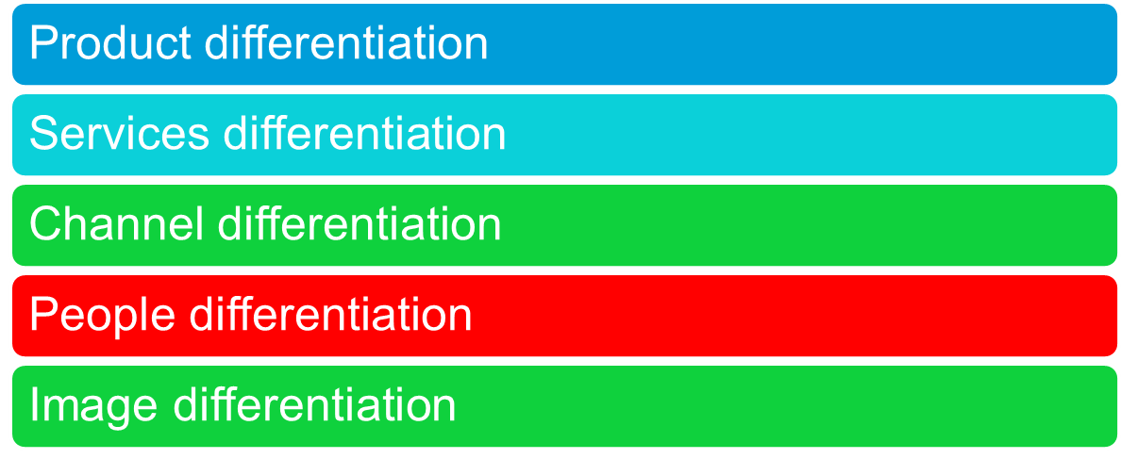
Differentiation and Positioning
Choosing a Differentiation and Positioning Strategy
Identifying a set of possible competitive advantages to build a position by providing superior value from:

Slide 37
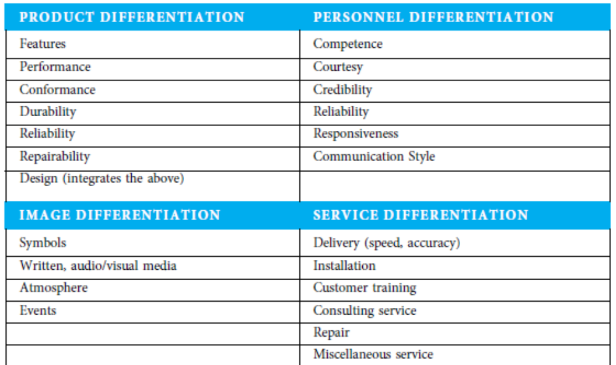

Slide 38




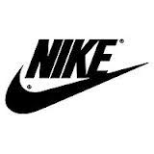


Slide 39
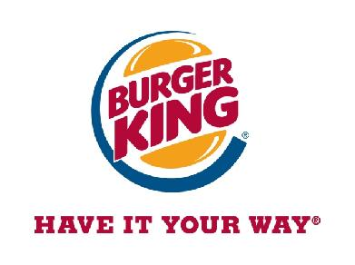

How many Differences to Promote?
One or More?
USP – Unique Selling Proposition

Slide 40
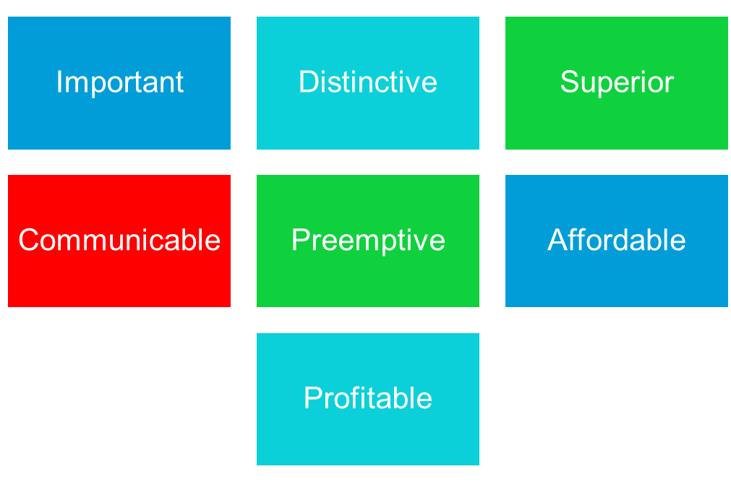
Differentiation and Positioning
Choosing the Right Competitive Advantage
Difference to promote should be:

Slide 41
Differentiation and Positioning
Selecting an Overall Positioning Strategy
Value proposition is the full mix of benefits upon which a brand is positioned

Slide 42
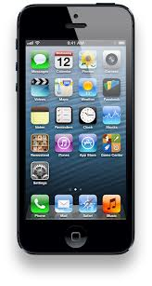
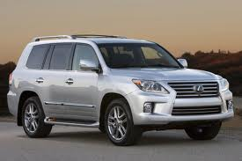

Value PROPOSITION
More for More
Premium products Apple I Phone
More for Same
Toyota at same price they will give a premium model
More for Less
Suzuki Liana or, Brite super detergent

Slide 43
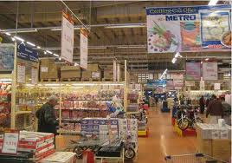

Value PROPOSITION
Same for Less
Big bazar, Walmart , Alfatah
Less for Much Less
By eliminating Unnecessary extras
e.g Fly dubai

Slide 44
Positioning Statement
A statement that summarizes company or brand Positioning.
To (Target segment and need) our (brand) is (concept) that (point of difference)
To busy mobile professionals who need to be in the loop our blackberry is a wireless connectivity solution that gives you an easier, more reliable way to stay connected to data, people and resources while on the go.

Slide 45
Communication and Delivering the Chosen Position
Choosing the positioning is often easier than implementing the position.

